Slide 1
JavaScript

Slide 2
SYNTAX
JavaScript can be implemented using JavaScript statements that are placed within the <script>... </script> HTML tags in a web page.
You can place the <script> tags, containing your JavaScript, anywhere within you web page, but it is normally recommended that you should keep it within the <head> tags.

Slide 3
The <script> tag alerts the browser program to start interpreting all the text between these tags as a script. A simple syntax of your JavaScript will appear as follows.
<script ...>
JavaScript code
</script>

Slide 4
The script tag takes two important attributes:
Language: This attribute specifies what scripting language you are using. Typically, its value will be javascript. Although recent versions of HTML (and XHTML, its successor) have phased out the use of this attribute.
Type: This attribute is what is now recommended to indicate the scripting language in use and its value should be set to "text/javascript".

Slide 5
<script language="javascript" type="text/javascript">
JavaScript code
</script>

Slide 6
Your First JavaScript Code
Let us take a sample example to print out "Hello World". We added an optional HTML comment that surrounds our JavaScript code. This is to save our code from a browser that does not support JavaScript. The comment ends with a "//->". Here "//" signifies a comment in JavaScript, so we add that to prevent a browser from reading the end of the HTML comment as a piece of JavaScript code. Next, we call a function document.write which writes a string into our HTML document.

Slide 7
Your First JavaScript Code
<html>
<body>
<script language="javascript" type="text/javascript">
<!--
document.write ("Hello World!")
//-->
</script>
</body>
</html>

Slide 8
Whitespace and Line Breaks
JavaScript ignores spaces, tabs, and newlines that appear in JavaScript programs. You can use spaces, tabs, and newlines freely in your program and you are free to format and indent your programs in a neat and consistent way that makes the code easy to read and understand.

Slide 9
Semicolons are Optional
Simple statements in JavaScript are generally followed by a semicolon character, just as they are in C, C++, and Java. JavaScript, however, allows you to omit this semicolon if each of your statements are placed on a separate line. For example, the following code could be written without semicolons.

Slide 10
Example
<script language="javascript" type="text/javascript">
<!--
var1 = 10
var2 = 20
//-->
</script>

Slide 11
But when formatted in a single line as follows, you must use semicolons:
<script language="javascript" type="text/javascript">
<!--
var1 = 10; var2 = 20;
//-->
</script>

Slide 12
Case Sensitivity
JavaScript is a case-sensitive language. This means that the language keywords, variables, function names, and any other identifiers must always be typed with a consistent capitalization of letters,
So the identifiers Time and TIME will convey different meanings in JavaScript.

Slide 13
Comments in JavaScript
JavaScript supports both C-style and C++-style comments. Thus:
Any text between a // and the end of a line is treated as a comment and is ignored by JavaScript.
Any text between the characters /* and */ is treated as a comment. This may span multiple lines.
JavaScript also recognizes the HTML comment opening sequence <!--. JavaScript treats this as a single-line comment, just as it does the // comment.
The HTML comment closing sequence --> is not recognized by JavaScript so it should be written as //-->.

Slide 14
The following example shows how to use comments in JavaScript.
<script language="javascript" type="text/javascript">
<!--
// This is a comment. It is similar to comments in C++
/*
* This is a multiline comment in JavaScript
* It is very similar to comments in C Programming
*/
//-->
</script>

Slide 15
PLACEMENT
There is a flexibility given to include JavaScript code anywhere in an HTML document. However the most preferred ways to include JavaScript in an HTML file are as follows:
Script in <head>...</head> section.
Script in <body>...</body> section.
Script in <body>...</body> and <head>...</head> sections.
Script in an external file and then include in <head>...</head> section.

Slide 16
JavaScript in <head>...</head> Section
If you want to have a script run on some event, such as when a user clicks somewhere, then you will place that script in the head as follows.

Slide 17
<html>
<head>
<script type="text/javascript">
<!--
function sayHello()
{
alert("Hello World")
}
//-->
</script>
</head>
<body>
Click here for the result
<input type="button" onclick="sayHello()" value="Say Hello" />
</body>
</html>

Slide 18
JavaScript in <body>...</body> Section
If you need a script to run as the page loads so that the script generates content in the page, then the script goes in the <body> portion of the document. In this case, you would not have any function defined using JavaScript. Take a look at the following code.

Slide 19
<html>
<head>
</head>
<body>
<script type="text/javascript">
<!--
document.write("Hello World")
//-->
</script>
<p>This is web page body </p>
</body>
</html>

Slide 20
JavaScript in External File
As you begin to work more extensively with JavaScript, you will be likely to find that there are cases where you are reusing identical JavaScript code on multiple pages of a site. You are not restricted to be maintaining identical code in multiple HTML files. The script tag provides a mechanism to allow you to store JavaScript in an external file and then include it into your HTML files.

Slide 21
Example
<html>
<head>
<script type="text/javascript" src="filename.js" ></script>
</head>
<body>
.......
</body>
</html>

Slide 22
filename.js
function sayHello() {
alert("Hello World")
}

Slide 23
VARIABLES
JavaScript allows you to work with three primitive data types:
Numbers, e.g., 123, 120.50 etc.
Strings of text, e.g. "This text string" etc.
Boolean, e.g. true or false.

Slide 24
JavaScript Variables
Like many other programming languages, JavaScript has variables. Variables can be thought of as named containers. You can place data into these containers and then refer to the data simply by naming the container. Before you use a variable in a JavaScript program, you must declare it. Variables are declared with the var keyword as follows.

Slide 25
<script type="text/javascript">
<!--
var money;
var name;
//-->
</script>

Slide 26
<script type="text/javascript">
<!--
var money, name;
//-->
</script>

Slide 27
JavaScript Variable Scope
The scope of a variable is the region of your program in which it is defined. JavaScript variables have only two scopes.
Global Variables: A global variable has global scope which means it can be defined anywhere in your JavaScript code.
Local Variables: A local variable will be visible only within a function where it is defined. Function parameters are always local to that function.

Slide 28
<script type="text/javascript">
<!--
var myVar = "global"; // Declare a global variable
function checkscope( )
{
var myVar = "local"; // Declare a local variable
document.write(myVar);
}
//-->
</script>

Slide 29
JavaScript Variable Names
While naming your variables in JavaScript, keep the following rules in mind.
• You should not use any of the JavaScript reserved keywords as a variable name. These keywords are mentioned in the next section. For example, break or boolean variable names are not valid.
• JavaScript variable names should not start with a numeral (0-9). They must begin with a letter or an underscore character. For example, 123test is an invalid variable name but _123test is a valid one.
• JavaScript variable names are case-sensitive. For example, Name and name are two different variables

Slide 30
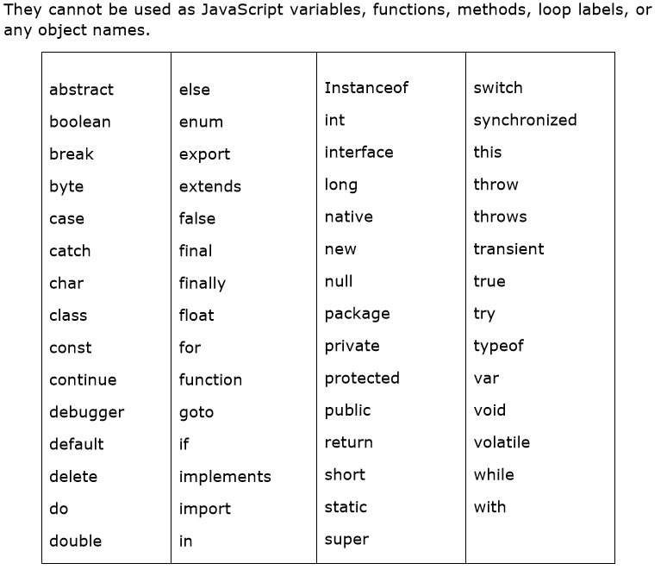
JavaScript Reserved Words

Slide 31
OPERATORS
What is an Operator? Let us take a simple expression 4 + 5 is equal to 9. Here 4 and 5 are called operands and ‘+’ is called the operator. JavaScript supports the following types of operators.
Arithmetic Operators
Comparison Operators
Logical (or Relational) Operators
Assignment Operators
Conditional (or ternary) Operators

Slide 32
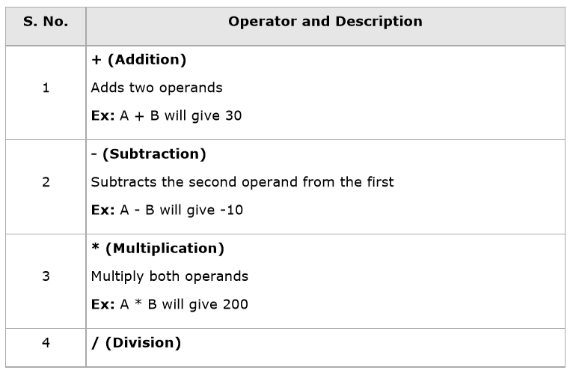
Arithmetic Operators
JavaScript supports the following arithmetic operators: Assume variable A holds 10 and variable B holds 20, then:

Slide 33
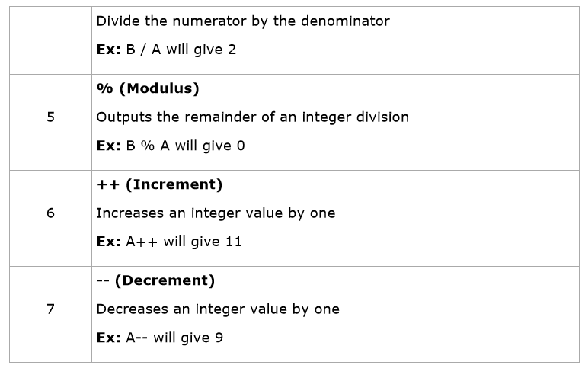

Slide 34
The following code shows how to use arithmetic operators in JavaScript.
<html>
<body>
<script type="text/javascript">
<!--
var a = 33;
var b = 10;
var c = "Test";
var linebreak = "<br />";
document.write("a + b = ");
result = a + b;
document.write(result);
document.write(linebreak);

Slide 35
document.write("a - b = ");
result = a - b;
document.write(result);
document.write(linebreak);
document.write("a / b = ");
result = a / b;
document.write(result);
document.write(linebreak);
document.write("a % b = ");
result = a % b;
document.write(result);
document.write(linebreak);
document.write("a + b + c = ");
result = a + b + c;
document.write(result);
document.write(linebreak);

Slide 36
a = a++;
document.write("a++ = ");
result = a++;
document.write(result);
document.write(linebreak);
b = b--;
document.write("b-- = ");
result = b--;
document.write(result);
document.write(linebreak);
//-->
</script>
<p>Set the variables to different values and then try...</p>
</body>
</html>

Slide 37
Output
a + b = 43
a - b = 23
a / b = 3.3
a % b = 3
a + b + c = 43Test
a++ = 33
b-- = 10

Slide 38
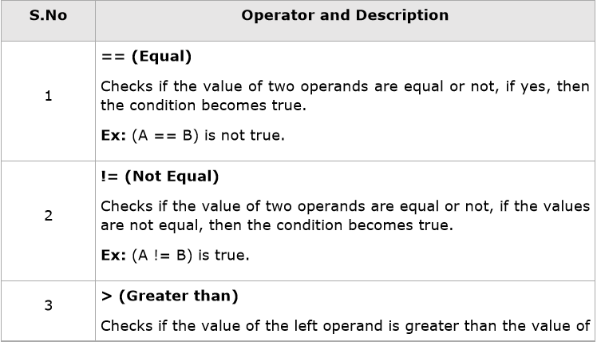
Comparison Operators
JavaScript supports the following comparison operators: Assume variable A holds 10 and variable B holds 20, then:

Slide 39
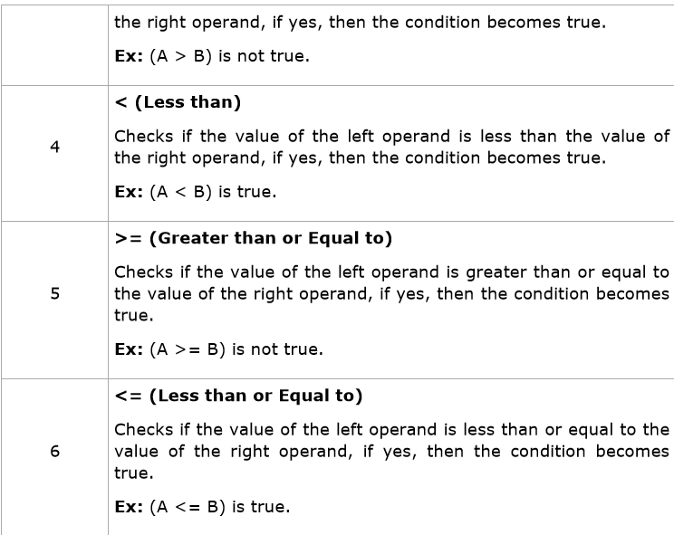

Slide 40
<html>
<body>
<script type="text/javascript">
<!--
var a = 10;
var b = 20;
var linebreak = "<br />";
document.write("(a == b) => ");
result = (a == b);
document.write(result);
document.write(linebreak);
document.write("(a < b) => ");
result = (a < b);
document.write(result);
document.write(linebreak);
document.write("(a > b) => ");
result = (a > b);
document.write(result);
document.write(linebreak);

Slide 41
document.write("(a != b) => ");
result = (a != b);
document.write(result);
document.write(linebreak);
document.write("(a >= b) => ");
result = (a >= b);
document.write(result);
document.write(linebreak);
document.write("(a <= b) => ");
result = (a <= b);
document.write(result);
document.write(linebreak);
//-->
</script>

Slide 42
output
(a == b) => false
(a < b) => true
(a > b) => false
(a != b) => true
(a >= b) => false
(a <= b) => true

Slide 43
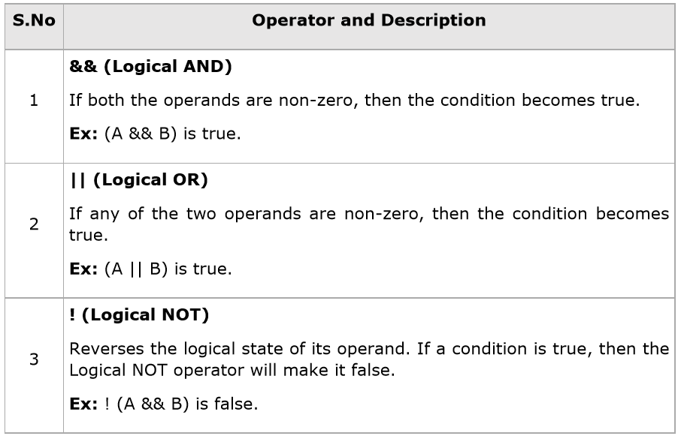
Logical Operators
JavaScript supports the following logical operators: Assume variable A holds 10 and variable B holds 20, then:

Slide 44
<html>
<body>
<script type="text/javascript">
<!--
var a = true;
var b = false;
var linebreak = "<br />";
document.write("(a && b) => ");
result = (a && b);
document.write(result);
document.write(linebreak);
document.write("(a || b) => ");
result = (a || b);
document.write(result);
document.write(linebreak);
document.write("!(a && b) => ");
result = (!(a && b));
document.write(result);
document.write(linebreak);
//-->
</script>

Slide 45
Output
(a && b) => false
(a || b) => true
!(a && b) => true

Slide 46
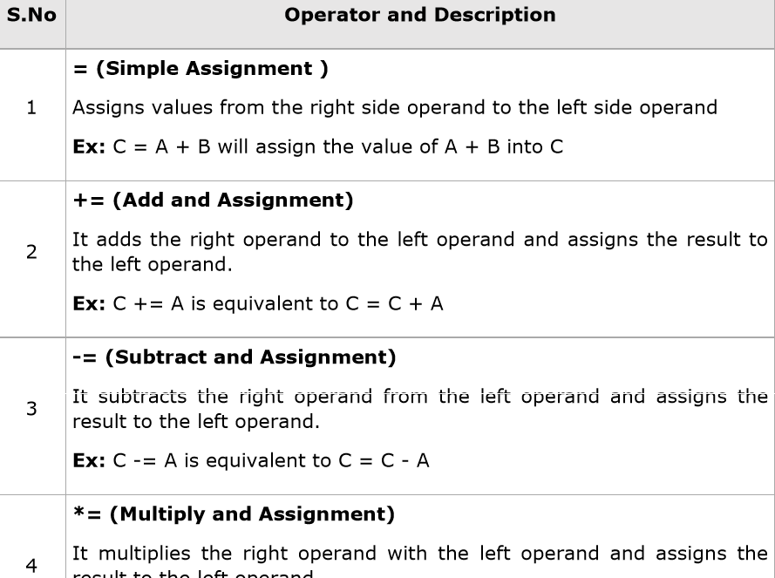
Assignment Operators

Slide 47
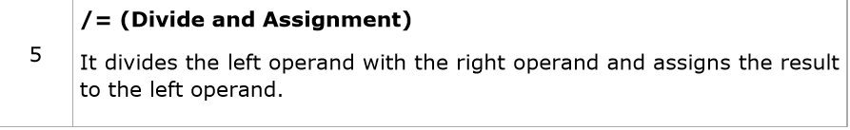
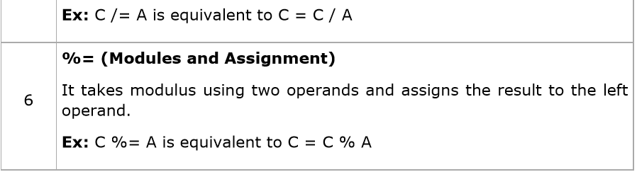

Slide 48
<html>
<body>
<script type="text/javascript">
<!--
var a = 33;
var b = 10;
var linebreak = "<br />";
document.write("Value of a => (a = b) => ");
result = (a = b);
document.write(result);
document.write(linebreak);
document.write("Value of a => (a += b) => ");
result = (a += b);
document.write(result);
document.write(linebreak);
//-->
</script>
<p>Set the variables to different values and different operators and then try...</p>
</body>
</html>

Slide 49
Output
Value of a => (a = b) => 10
Value of a => (a += b) => 20

Slide 50
if...else Statement
<html>
<body>
<script type="text/javascript">
<!--
var age = 15;
if( age > 18 ){
document.write("<b>Qualifies for driving</b>");
}else{
document.write("<b>Does not qualify for driving</b>");
}

Slide 51
While Loop
<html>
<body>
<script type="text/javascript">
<!--
var count = 0;
document.write("Starting Loop ");
while (count < 10){
document.write("Current Count : " + count + "<br />");
count++;
}
document.write("Loop stopped!");
//-->
</script>
<p>Set the variable to different value and then try...</p>
</body>
</html>

Slide 52
The do...while Loop
<html>
<body>
<script type="text/javascript">
<!--
var count = 0;
document.write("Starting Loop" + "<br />");
do{
document.write("Current Count : " + count + "<br />");
count++;
}while (count < 5);
document.write ("Loop stopped!");
//-->
</script>
<p>Set the variable to different value and then try...</p>
</body>
</html>

Slide 53
For Loop
<html>
<body>
<script type="text/javascript">
<!--
var count;
document.write("Starting Loop" + "<br />");
for(count = 0; count < 10; count++){
document.write("Current Count : " + count );
document.write("<br />");
}
document.write("Loop stopped!");
//-->
</script>
<p>Set the variable to different value and then try...</p>
</body>
</html>

Slide 54
FUNCTIONS
JavaScript allows us to write our own functions as well. This section explains how to write your own functions in JavaScript.
Function Definition
Before we use a function, we need to define it. The most common way to define a function in JavaScript is by using the function keyword, followed by a unique function name, a list of parameters (that might be empty), and a statement block surrounded by curly braces.

Slide 55
<script type="text/javascript">
<!--
function sayHello()
{
alert("Hello there");
}
//-->
</script>

Slide 56
Calling a Function
<html>
<head>
<script type="text/javascript">
function sayHello()
{
document.write ("Hello there!");
}
</script>
</head>
<body>
<p>Click the following button to call the function</p>
<form>
<input type="button" onclick="sayHello()" value="Say Hello">
</form>
<p>Use different text in write method and then try...</p>
</body>
</html>

Slide 57
Function Parameters
A function can take multiple parameters separated by comma.

Slide 58
<html>
<head>
<script type="text/javascript">
function sayHello(name, age)
{
document.write (name + " is " + age + " years old.");
}
</script>
</head>
<body>
<p>Click the following button to call the function</p>
<form>
<input type="button" onclick="sayHello('Zara', 7)" value="Say Hello">
</form>
<p>Use different parameters inside the function and then try...</p>
</body>
</html>

Slide 59
The return Statement
A JavaScript function can have an optional return statement. This is required if you want to return a value from a function. This statement should be the last statement in a function. For example, you can pass two numbers in a function and then you can expect the function to return their multiplication in your calling program.

Slide 60
<html>
<head>
<script type="text/javascript">
function concatenate(first, last)
{
var full;
full = first + last;
return full;
}
function secondFunction()
{
var result;
result = concatenate('Zara', 'Ali');
document.write (result );
}
</script>
</head>

Slide 61
<body>
<p>Click the following button to call the function</p>
<form>
<input type="button" onclick="secondFunction()" value="Call Function">
</form>
<p>Use different parameters inside the function and then try...</p>
</body>
</html>

Slide 62
EVENTS
JavaScript's interaction with HTML is handled through events that occur when the user or the browser manipulates a page. When the page loads, it is called an event. When the user clicks a button, that click too is an event. Other examples include events like pressing any key, closing a window, resizing a window, etc. Developers can use these events to execute JavaScript coded responses, which cause buttons to close windows, messages to be displayed to users, data to be validated, and virtually any other type of response imaginable. Events are a part of the Document Object Model (DOM) Level 3 and every HTML element contains a set of events which can trigger JavaScript Code.

Slide 63
onclick Event Type
This is the most frequently used event type which occurs when a user clicks the left button of his mouse. You can put your validation, warning etc., against this event type.

Slide 64
<html>
<head>
<script type="text/javascript">
<!--
function sayHello() {
document.write ("Hello World")
}
//-->
</script>

Slide 65
</head>
<body>
<p> Click the following button and see result</p>
<input type="button" onclick="sayHello()" value="Say Hello" />
</body>
</html>

Slide 66
onsubmit Event Type
onsubmit is an event that occurs when you try to submit a form. You can put your form validation against this event type.
Example The following example shows how to use onsubmit. Here we are calling a validate() function before submitting a form data to the webserver. If validate() function returns true, the form will be submitted, otherwise it will not submit the data.

Slide 67
<html>
<head>
<script type="text/javascript">
<!--
function validation() {
all validation goes here
.........
return either true or false
}
//-->
</script>
</head>

Slide 68
<body>
<form method="POST" action="t.cgi" onsubmit="return validate()">
.......
<input type="submit" value="Submit" />
</form>
</body>
</html>

Slide 69
onmouseover and onmouseout
These two event types will help you create nice effects with images or even with text as well. The onmouseover event triggers when you bring your mouse over any element and the onmouseout triggers when you move your mouse out from that element. Try the following example.

Slide 70
<html>
<head>
<script type="text/javascript">
<!--
function over() {
document.write ("Mouse Over");
}
function out() {
document.write ("Mouse Out");
}
//-->
</script>
</head>
<body>
<p>Bring your mouse inside the division to see the result:</p>
<div onmouseover="over()" onmouseout="out()">
<h2> This is inside the division </h2>
</div>
</body>
</html>

Slide 71
DIALOG BOX
JavaScript supports three important types of dialog boxes. These dialog boxes can be used to raise and alert, or to get confirmation on any input or to have a kind of input from the users. Here we will discuss each dialog box one by one.

Slide 72
Alert Dialog Box
An alert dialog box is mostly used to give a warning message to the users. For example, if one input field requires to enter some text but the user does not provide any input, then as a part of validation, you can use an alert box to give a warning message. Nonetheless, an alert box can still be used for friendlier messages. Alert box gives only one button "OK" to select and proceed.

Slide 73
<html>
<head>
<script type="text/javascript">
<!--
function Warn() {
alert ("This is a warning message!");
document.write ("This is a warning message!");
}
//-->
</script>
</head>
<body>
<p>Click the following button to see the result: </p>
<form>
<input type="button" value="Click Me" onclick="Warn();" />
</form>
</body>
</html>

Slide 74
Confirmation Dialog Box
A confirmation dialog box is mostly used to take user's consent on any option. It displays a dialog box with two buttons: OK and Cancel. If the user clicks on the OK button, the window method confirm() will return true. If the user clicks on the Cancel button, then confirm() returns false. You can use a confirmation dialog box as follows.
Example

Slide 75
<html>
<head>
<script type="text/javascript">
<!--
function getConfirmation(){
var retVal = confirm("Do you want to continue ?");
if( retVal == true ){
document.write ("User wants to continue!");
return true;
}else{
Document.write ("User does not want to continue!");
return false;
}
}
//-->
</script>
</head>
<body>
<p>Click the following button to see the result: </p>
<form>

Slide 76
<input type="button" value="Click Me" onclick="getConfirmation();" />
</form>
</body>
</html>

Slide 77
Prompt Dialog Box
The prompt dialog box is very useful when you want to pop-up a text box to get user input. Thus, it enables you to interact with the user. The user needs to fill in the field and then click OK.
This dialog box is displayed using a method called prompt() which takes two parameters: (i) a label which you want to display in the text box and (ii) a default string to display in the text box.
This dialog box has two buttons: OK and Cancel. If the user clicks the OK button, the window method prompt() will return the entered value from the text box. If the user clicks the Cancel button, the window method prompt() returns null.

Slide 78
<html>
<head>
<script type="text/javascript">
<!--
function getValue()
{
var retVal = prompt("Enter your name : ", "your name here");
document.write("You have entered : " + retVal);
}
//-->

Slide 79
</script>
</head>
<body>
<p>Click the following button to see the result: </p>
<form>
<input type="button" value="Click Me" onclick="getValue();" />
</form>
</body>
</html>

Slide 80
PAGE PRINTING
Many times you would like to place a button on your webpage to print the content of that web page via an actual printer. JavaScript helps you to implement this functionality using the print function of window object.
The JavaScript print function window.print() prints the current web page when executed. You can call this function directly using the onclick event as shown in the following example.

Slide 81
<head>
<script type="text/javascript">
<!--
//-->
</script>
</head>
<body>
<form>
<input type="button" value="Print" onclick="window.print()" />
</form>
</body>

Slide 82
FORM VALIDATION
Form validation normally used to occur at the server, after the client had entered all the necessary data and then pressed the Submit button. If the data entered by a client was incorrect or was simply missing, the server would have to send all the data back to the client and request that the form be resubmitted with correct information. This was really a lengthy process which used to put a lot of burden on the server. JavaScript provides a way to validate form's data on the client's computer before sending it to the web server. Form validation generally performs two functions.

Slide 83
Basic Validation - First of all, the form must be checked to make sure all the mandatory fields are filled in. It would require just a loop through each field in the form and check for data.
Data Format Validation - Secondly, the data that is entered must be checked for correct form and value. Your code must include appropriate logic to test correctness of data.

Slide 84
Basic Form Validation
First let us see how to do a basic form validation. In the above form, we are calling validate() to validate data when onsubmit event is occurring. The following code shows the implementation of this validate() function.

Slide 85
<script type="text/javascript">
<!--
// Form validation code will come here.
function validate()
{
if( document.myForm.Name.value == "" )
{
alert( "Please provide your name!" );
document.myForm.Name.focus() ;
return false;
}
if( document.myForm.EMail.value == "" )
{
alert( "Please provide your Email!" );
document.myForm.EMail.focus() ;
return false;
}

Slide 86
if( document.myForm.Zip.value == "" ||
isNaN( document.myForm.Zip.value ) ||
document.myForm.Zip.value.length != 5 )
{
alert( "Please provide a zip in the format #####." );
document.myForm.Zip.focus() ;
return false;
}
if( document.myForm.Country.value == "-1" )
{
alert( "Please provide your country!" );
return false;
}
return( true );
}
//-->
</script>

Slide 87
Data Format Validation
Now we will see how we can validate our entered form data before submitting it to the web server. The following example shows how to validate an entered email address. An email address must contain at least a ‘@’ sign and a dot (.). Also, the ‘@’ must not be the first character of the email address, and the last dot must at least be one character after the ‘@’ sign.

Slide 88
<script type="text/javascript">
<!--
function validateEmail()
{
var emailID = document.myForm.EMail.value;
atpos = emailID.indexOf("@");
dotpos = emailID.lastIndexOf(".");
if (atpos < 1 || ( dotpos - atpos < 2 ))
{
alert("Please enter correct email ID")
document.myForm.EMail.focus() ;
return false;
}
return( true );
}
//-->
</script>

Slide 89
Date
The Date object is a datatype built into the JavaScript language. Date objects are created with the new Date() as shown below.
Once a Date object is created, a number of methods allow you to operate on it. Most methods simply allow you to get and set the year, month, day, hour, minute, second, and millisecond fields of the object, using either local time or UTC (universal, or GMT) time.

Slide 90
Syntax You can use any of the following syntaxes to create a Date object using Date() constructor
new Date( )
new Date(milliseconds)
new Date(datestring)
NewDate(year,month,date[,hour,minute,second,millisecond ])

Slide 91
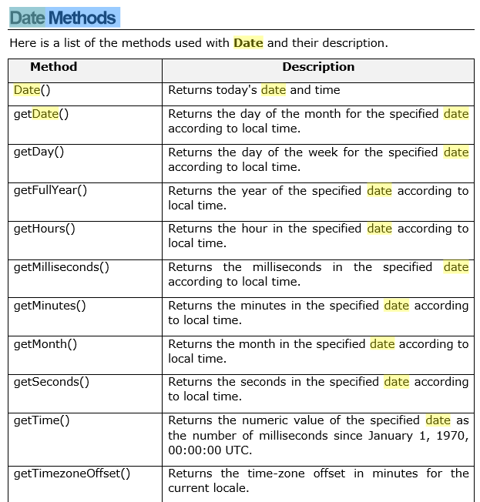
Date Methods

Slide 92
<html>
<head>
<title>JavaScript Date Method</title>
</head>
<body>
<script type="text/javascript">
var dt = Date();
document.write("Date and Time : " + dt );
</script>
</body>
</html>

Slide 93
getDate()
Javascript date getDate() method returns the day of the month for the specified date according to local time. The value returned by getDate is an integer between 1 and 31.

Slide 94
JavaScript Objects
JavaScript is an Object Oriented Programming (OOP) language. A programming language can be called object-oriented if it provides four basic capabilities to developers:
Encapsulation: the capability to store related information, whether data or methods, together in an object.
Aggregation: the capability to store one object inside another object.
Inheritance: the capability of a class to rely upon another class (or number of classes) for some of its properties and methods.
Polymorphism: the capability to write one function or method that works in a variety of different ways.

Slide 95
User-Defined Objects
The new Operator The new operator is used to create an instance of an object. To create an object, the new operator is followed by the constructor method. In the following example, the constructor methods are Object(), Array(), and Date(). These constructors are built-in JavaScript functions.

Slide 96
var employee = new Object();
var books = new Array("C++", "Perl", "Java");
var day = new Date("August 15, 1947");

Slide 97
The Object ( ) Constructor
A constructor is a function that creates and initializes an object. JavaScript provides a special constructor function called Object() to build the object. The return value of the Object() constructor is assigned to a variable. The variable contains a reference to the new object. The properties assigned to the object are not variables and are not defined with the var keyword.

Slide 98
<html>
<head>
<title>User-defined objects</title>
<script type="text/javascript">
var book = new Object(); // Create the object
book.subject = "Perl"; // Assign properties to the object

Slide 99
book.author = "Mohtashim";
</script>
</head>
<body>
<script type="text/javascript">
document.write("Book name is : " + book.subject + "<br>");
document.write("Book author is : " + book.author + "<br>");
</script>
</body>
</html>

Slide 100
Form Validation Example
<html>
<head>
<script language='javascript'>
function validate_form()
{
var fname = document.validate.fname.value;
var lname=document.validate.lname.value;
var address=document.validate.address.value;
var email=document.validate.email.value;
var dept=document.validate.Dept;
var comment=document.validate.comment.value;
var mobileno=document.validate.Mno.value;
if(fname=="")
{
alert("Enter your First Name");
return false;
}
else if(lname=="")
{
alert("Enter your Last Name");
return false;
}
else if(address=="")
{
alert("Enter your Address");
return false;
}

Slide 101
else if(email=="")
{
alert("Enter your Email Address");
return false;
}
if(email.indexOf("@",0)<0)
{
alert("Enter Valid Email Address");
return false;
}
if(email.indexOf(".",0)==-1)
{
alert("Enter Valid Email Address");
return false;
}
else if(dept.selectedIndex==0)
{
alert("Select the Proper Option");
return false;
}
else if(comment=="")
{
alert("Enter Comment");
return false;
}
else if(mobileno=="")
{
alert("Enter your Mobile Number");
return false;
}

Slide 102
else
{
alert("Information Submitted Successfully");
return true;
}
}
</script>

Slide 103
</head>
<body>
<form name ="validate" action ="form_validate.html" method="post" onsubmit="return validate_form()">
<table border=2 align='center'>
<caption><b><font size=5> Insert Student Information</font></b></caption>
<tr>
<td>
<table border rules='cols' cellspacing='5'>
<tr>
<td>First_Name:
<td><input type='text' name='fname'>
<td>Last_Name:
<td><input type='text' name='lname'>
</table>
<table border rules='rows' cellspacing='5'>
<tr>
<td>
<tr>
<td>Address:
<td><textarea name='address' rows='3' cols='46'></textarea>
<tr>
<td>Email:
<td><input type='text' name='email'>
<tr>
<td>Department:
<td><select name='Dept' value=''>
<option></option>
<option value=''>IT</option>
<option value=''>Computer</option>
<option value=''>Civil</option>
<option value=''>E & TC</option>
<option value=''>Other</option>
</select>

Slide 104
clock
<html>
<head>
<script language='javascript'>
function clock()
{
var time=new Date();
var hrs=time.getHours();
var minutes=time.getMinutes();
var seconds=time.getSeconds();
if (hrs>=12)
AMPM='PM';
else
AMPM='AM';
if(hrs>12)
hrs=hrs-12;
if(hrs==0)
hrs=12;
if(minutes<10)
minutes='0'+minutes;
if(seconds<10)
seconds='0'+seconds;
document.fclock.clock.value=hrs+":"+minutes+":"+seconds+" "+AMPM
setTimeout("clock()",1000);
}
</script>
</head>

Slide 105
<body onload='clock()'>
<form name='fclock' >
<center><font face='castellar' size=6 color='green'><b>Clock:<input type='text' name='clock'></b></font></center></form>
</body>
</html>

